Slide 1
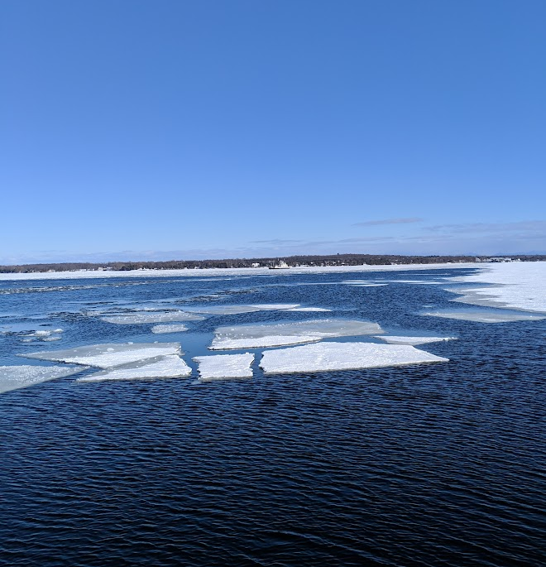
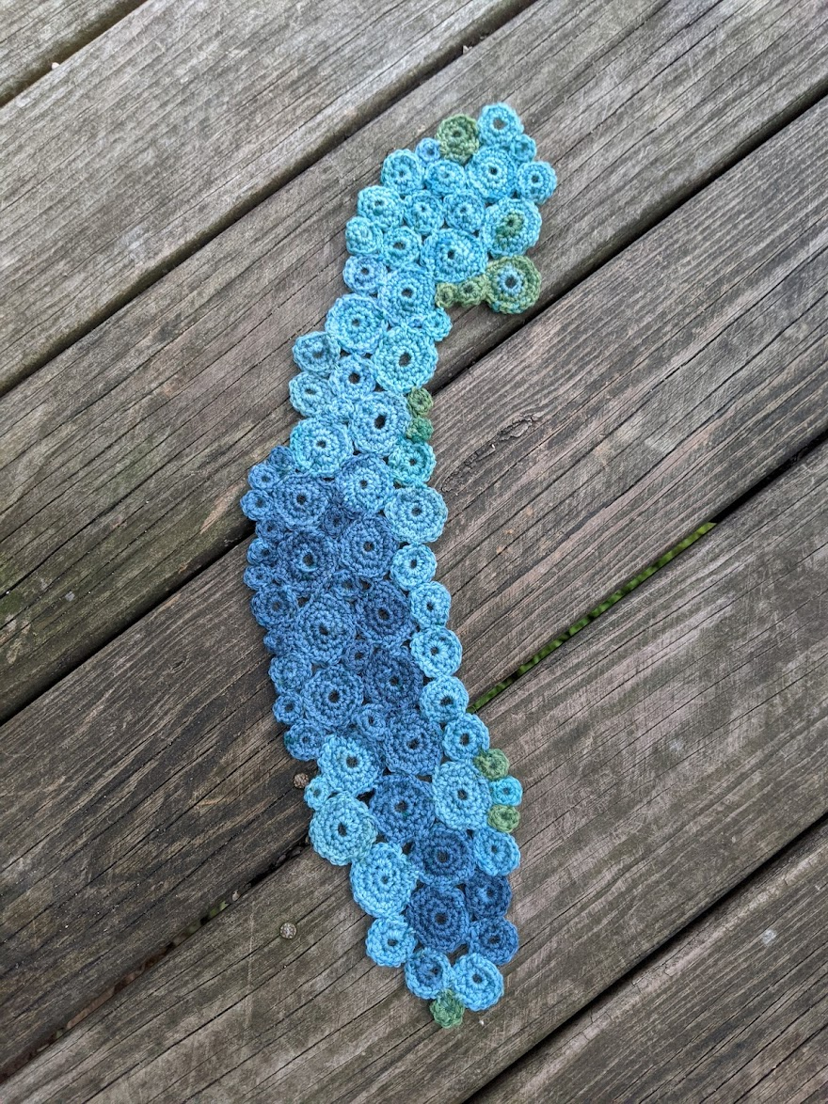
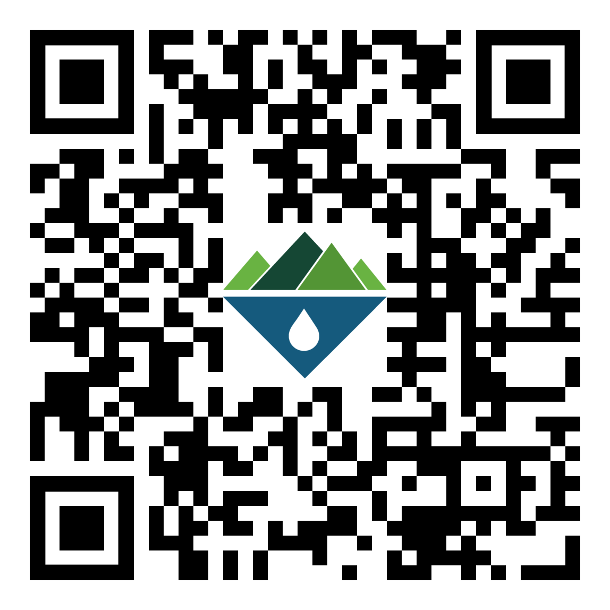
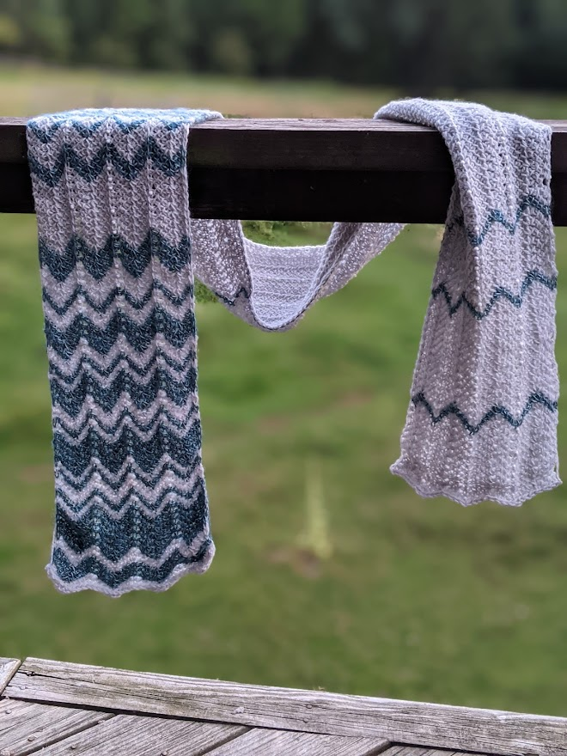
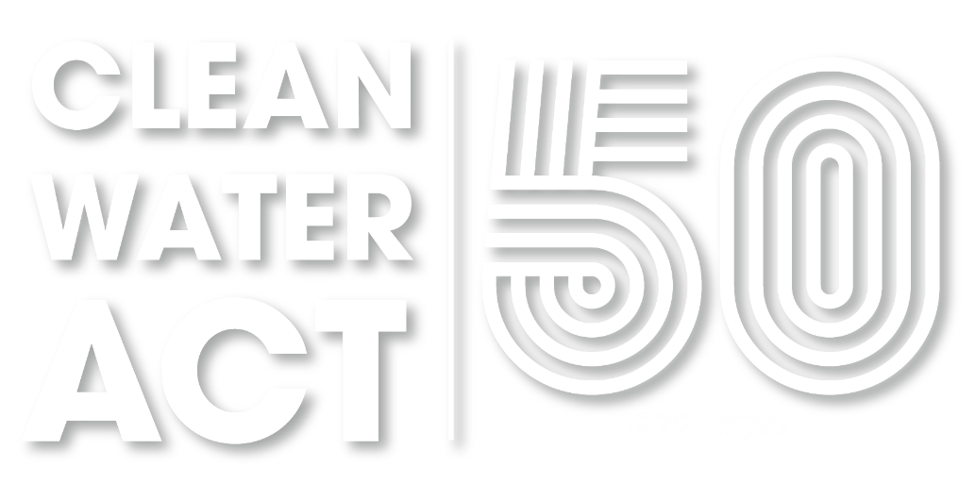
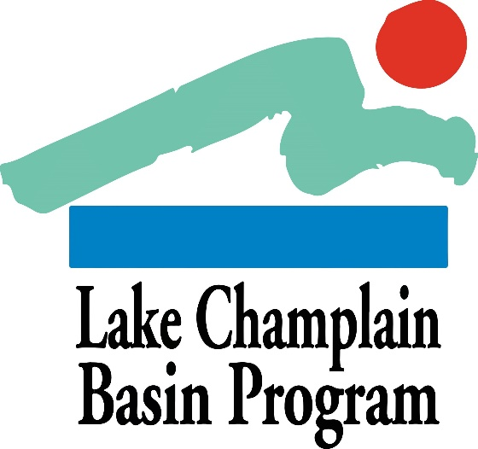
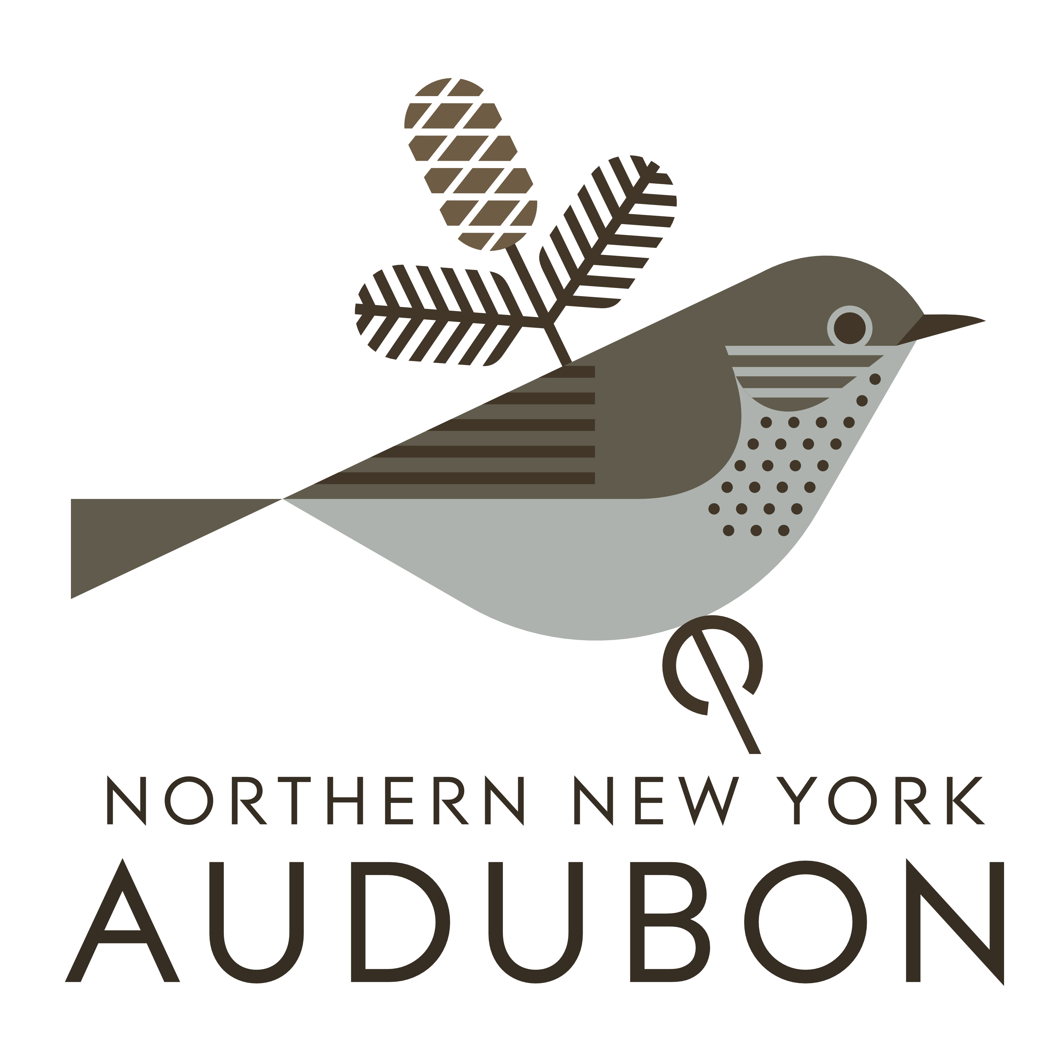
Wool and Water
A Project of the Paul Smith’s College Adirondack Watershed Institute
Wool and Water is a collaborative data art project that blends fiber art with scientific data to create visual representations of changing water quality conditions in the Adirondacks and Lake Champlain Basin

Slide 2
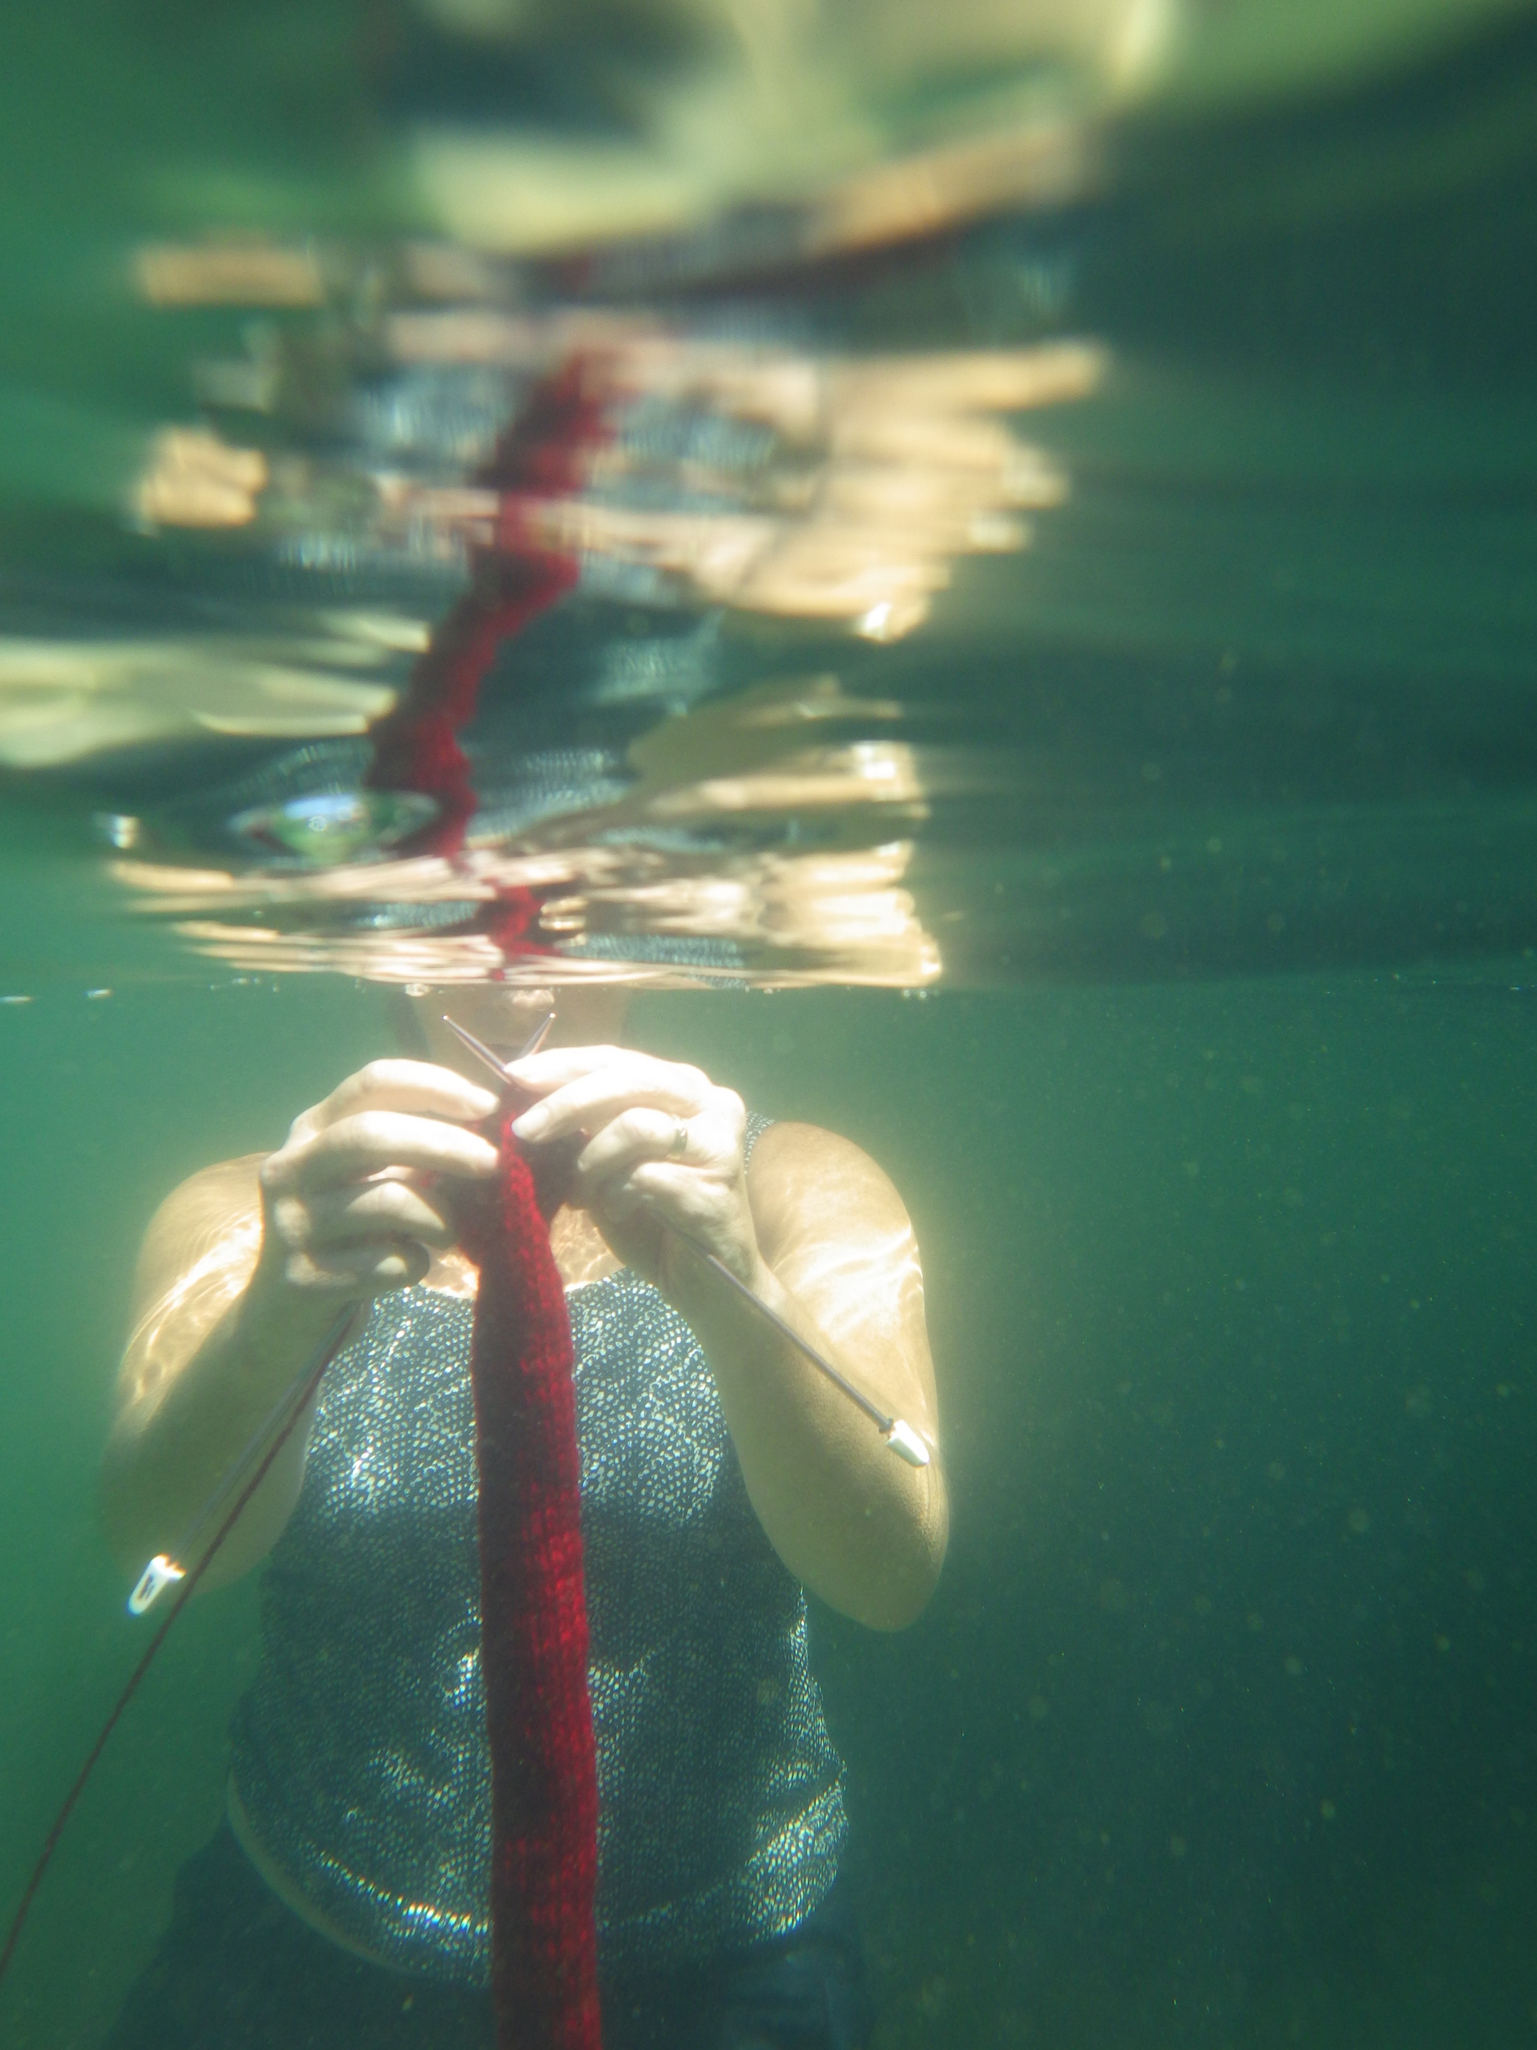
Wool and Water
A Project of the Paul Smith’s College
Adirondack Watershed Institute
Wool and Water is a collaborative data art project that blends fiber art with scientific data to create visual representations of changing water quality conditions in the Adirondacks and Lake Champlain Basin and to celebrate the 50-year anniversary of the Clean Water Act. The physical collection was created by Michale Glennon and contributing participants.
Scan to learn more!

Slide 3
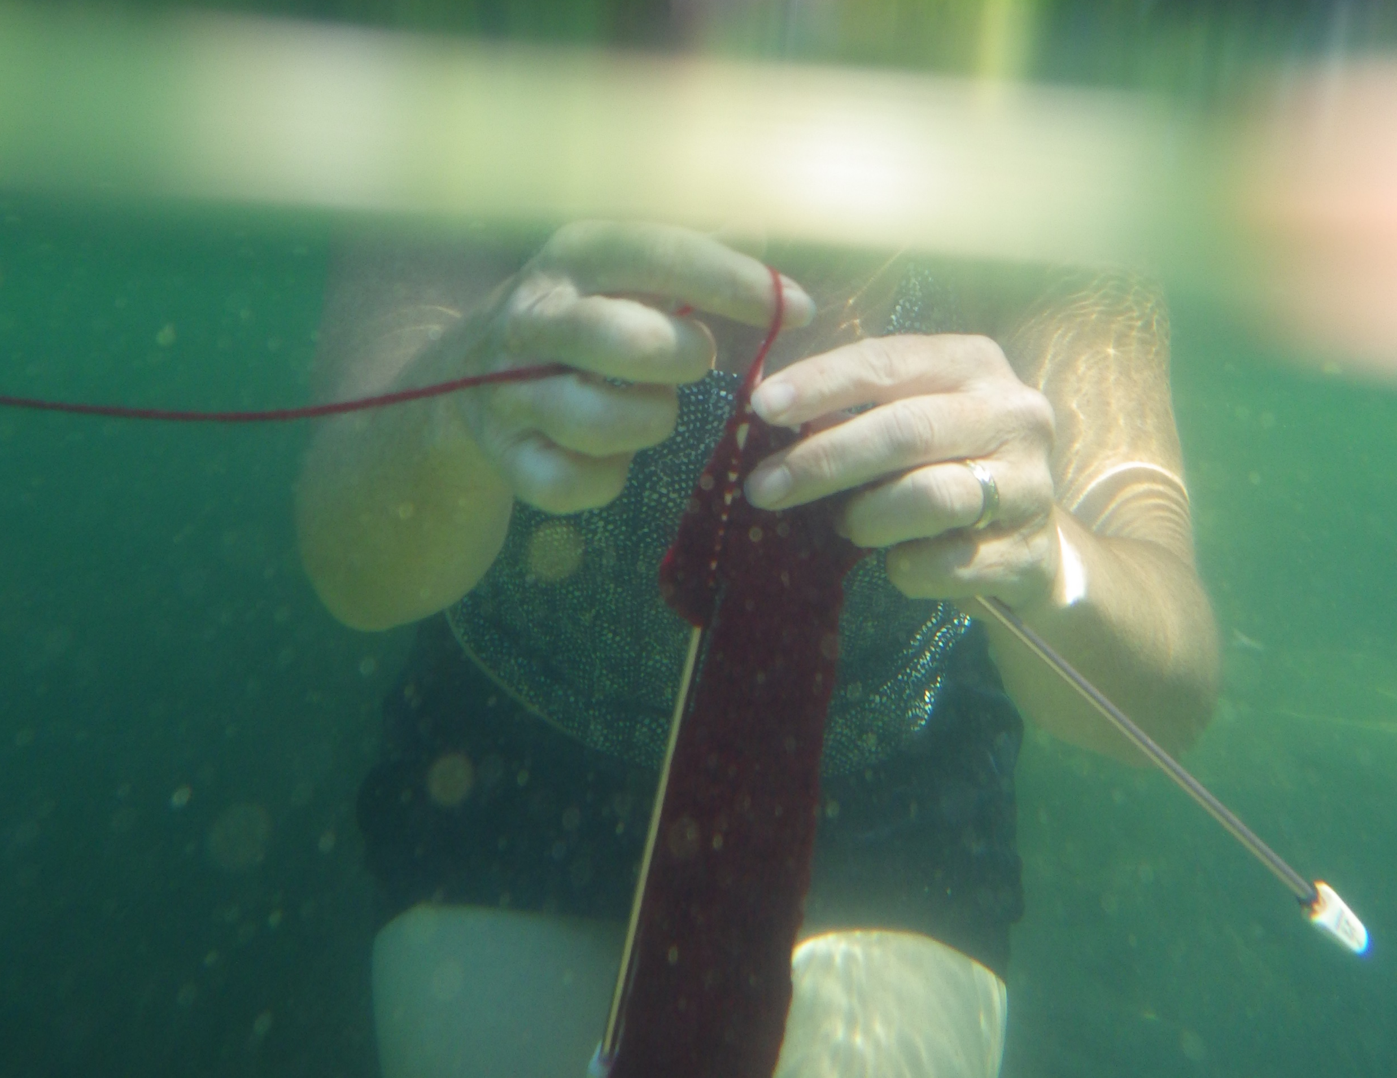
Wool and Water
A Project of the Paul Smith’s College Adirondack Watershed Institute
Wool and Water is a collaborative data art project that blends fiber art with scientific data to create visual representations of changing water quality conditions in the Adirondacks and Lake Champlain Basin

Slide 4
